Slide 1
Strategy Pattern
Michael Sawula
2/18/2019

Slide 2
Strategy Pattern
Definition
The intent of the Strategy Pattern is to define a family of algorithms, encapsulate each one, and make them interchangeable within that family
Strategy Pattern lets the algorithm vary independently from the clients that use it
Also known as the “Policy Pattern”
The Strategy Pattern enables an algorithm’s behavior to be selected at runtime

Slide 3
Strategy Pattern
Applicability
Use the strategy pattern when:
  You have many related classes that differ only in their behavior
    Strategies provide a way to configure a class with one of many behaviors
  You need different variants of an algorithm
    For example, you might define algorithms reflecting different space/time trade-offs
  When an algorithm uses data that clients shouldn’t know about.
    Use the Strategy Pattern to avoid exposing complex, algorithm-specific data structures
  A class defines many behaviors, and these appear as multiple conditional statements in its operations.
    Move related conditional branches into their own strategy class

Slide 4
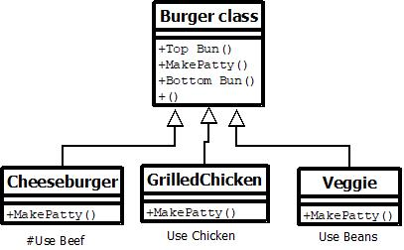
Strategy Pattern
Example
Consider a fast food restaurant where a customer wants to order a burger
There are many varieties of burgers: cheeseburger (made with a beef patty), grilled chicken burger, veggie burger
  Consistent format: bottom bun + patty + top bun
  The main difference lies in what the patty is made of
One possible approach…
  Create a “Burger” class as well as class for each type
  of burger patty/stuffing. Use inheritance
  Burger class could have a default “Make Patty” operation,
  and each subclass would override “Make Patty”
  with its own version
  Risk creating copious amounts of duplicate code and
  it becomes more difficult to add and maintain
  new algorithms
Example inspired by https://medium.freecodecamp.org (see references for detail)

Slide 5
Strategy Pattern
Example (continued)
Similar format: bottom bun + patty + top bun
  patty for a cheeseburger = cheese + beef patty
  patty for a chicken burger = grilled chicken breast
  patty for a veggie burger = soybeans, tofu, nuts, grains etc.
Recall: the intent of the Strategy Pattern is to define a family of algorithms, encapsulate each one, and make them interchangeable within that family
In this example, the family of algorithms = the family of different patties
  They are encapsulated and interchangeable with each other

Slide 6

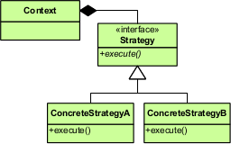
Strategy Pattern
Structure
The Context class doesn't implement an algorithm directly
Instead, Context class refers to the Strategy interface for performing an algorithm. This makes Context independent of how an algorithm is implemented
We can change behavior without affecting our Context
The ConcreteStrategyA and ConcreteStrategyB classes implement the Strategy interface i.e. they implement (encapsulate) an algorithm
General idea is to capture the abstraction in an interface and bury implementation details in derived classes

Slide 7
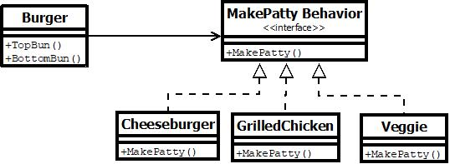
Strategy Pattern
Example
The key to the strategy pattern is to pull the varying algorithms out into a separate object. These objects become a family of algorithms the context (Burger) can choose from. Each of these objects, aka the strategies, does the same job and supports the same interface

Slide 8
Strategy Pattern
Python Demonstration
https://www.pythonanywhere.com

Slide 9
Strategy Pattern
Benefits and other considerations
It achieves better separation of concerns by pulling out a set of strategies from a class
  In our example, it relieves the Burger class of any responsibility for our knowledge of the stuffing
  Strategies can provide different implementations of the same behavior
By encapsulating the algorithm separately, new algorithms complying with the same interface can be easily introduced
  Encapsulating the algorithm in separate Strategy classes lets you vary the algorithm independently of its context, making it easier to switch, understand and extend
It makes it easy to switch strategies at runtime because the pattern is based on composition and delegation, rather than on inheritance (moving from “is a” to “has a”
Strategies eliminate conditional statements
  This enables the client to choose the required algorithm, without using a “switch” statement or a series of “if-else” statements
However, applications/clients must be aware of all the strategies to select the right one for the right situation
Use strategy pattern only when the variation in behavior is relevant to clients
Strategies increase the number of objects in an application

Slide 10
Strategy Pattern
Sources
Design Patterns, Gamma, et. al.
https://sourcemaking.com/design_patterns/strategy
https://medium.freecodecamp.org/how-can-you-learn-the-strategy-design-pattern-make-a-hamburger-a6ad4332b838
https://www.geeksforgeeks.org/strategy-pattern-set-1/
Strategy Design Pattern (https://www.youtube.com/watch?v=-NCgRD9-C6o)
Strategy Pattern – Design Patterns (ep 1) (https://www.youtube.com/watch?v=v9ejT8FO-7I)
https://en.wikipedia.org/wiki/Strategy_pattern

