Slide 1
Proxy Pattern
Trevor Serrao

Slide 2
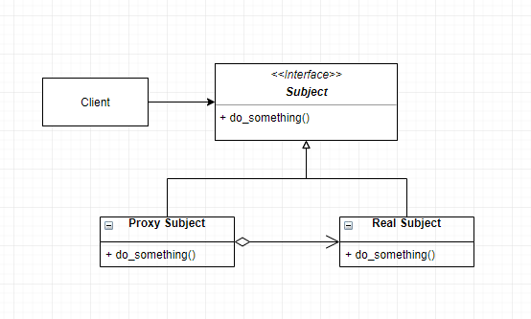
Proxy Pattern UML

Slide 3
Usage scenarios
Virtual Proxy: defer costs and prevent duplication
  Loading images in a large document
Protective Proxy: ensure appropriate access permissions
  Enforcing institutional web browsing restrictions
Smart Proxy: execute specific actions upon the client’s request
  Check for a read-lock when opening a document
Remote proxy: local representation of an external object
  Client can behave as if the object is local

Slide 4
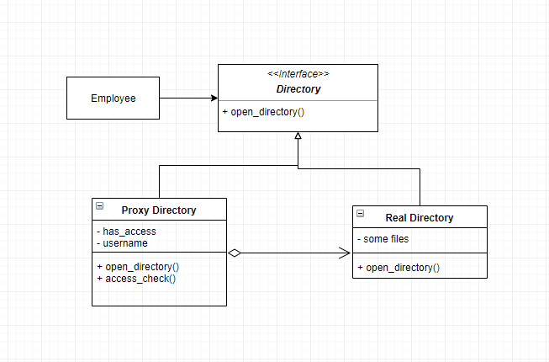
Directory Example UML

