Slide 1
Design
OO
Class Diagram
Sequence Diagram
Video1: https://drive.google.com/open?id=1QsfEvm18625v9wAWypSPIDTVGbFnKmOQ
You have to use your UChicago account to log in to watch the above video
Video2: embedded in slide 10
Video3: embedded in slide 11

Slide 2
Sequence diagram
Describes how objects collaborate/interact with each other in one scenario

Slide 3
Sequence diagram
Describes how objects collaborate/interact with each other in one scenario
int Counter::inc(int x){
count+=x;
return count;
}

Slide 4
Sequence diagram
Describes how objects collaborate/interact with each other in one scenario
bool Account::StoC(int amount){
SavingCounter.dec(amount);
CheckingCounter.inc(amount);
return true;
}

Slide 5
Components of sequence diagram
Participants
Life-line
Activation bar
Message
  Regular calls, self calls
Creating and deleting object
Loops and conditionals
  loop, alt, opt
http://en.wikipedia.org/wiki/Sequence_diagram
Notes:
Loop, opt, alt

Slide 6
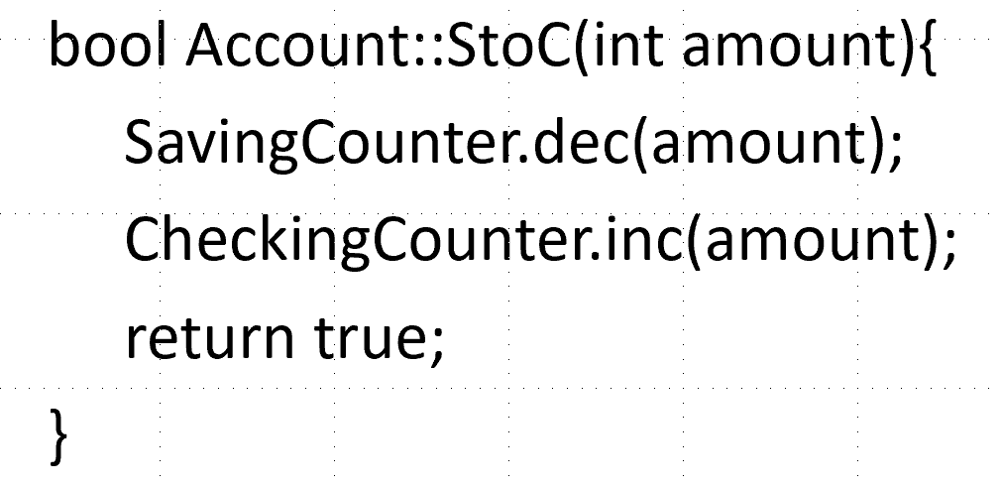

Slide 7
Components of sequence diagram
Participants
Life-line
Activation bar
Message
  Regular calls, self calls
Creating and deleting object
Loops and conditionals
  loop, alt, opt
http://en.wikipedia.org/wiki/Sequence_diagram
Notes:
Loop, opt, alt

Slide 8
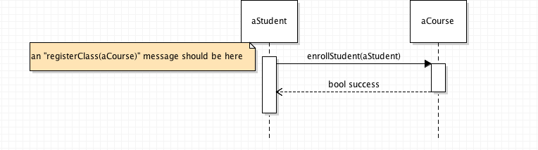
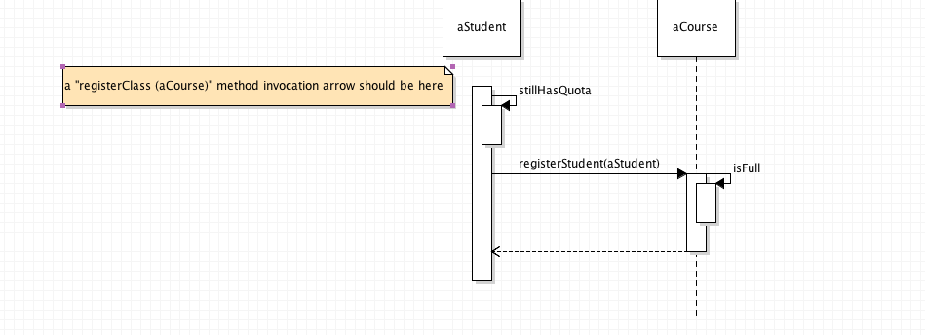
Sequence diagram example 1

Slide 9
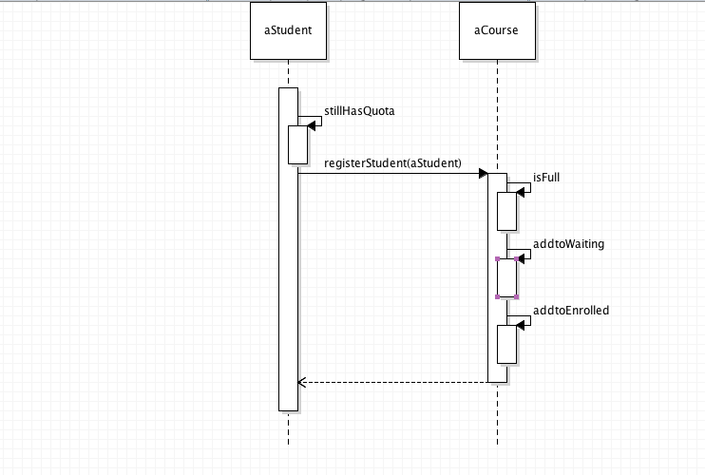
Sequence diagram example 2
registerClasses(Course[] courses)
[for every course]
loop
alt
[full]
[else]

Slide 10
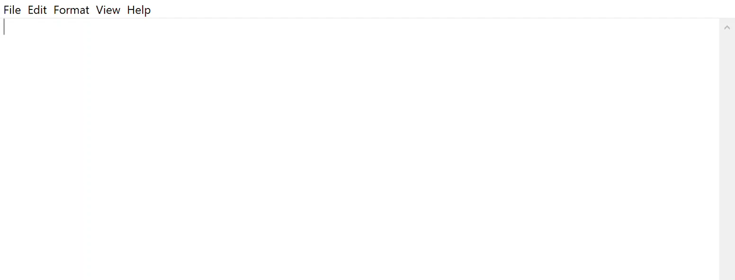
How to turn seq. diagram to code (1)
Hey, a video is embedded above with explanation.
Remember to click and watch!

Slide 11
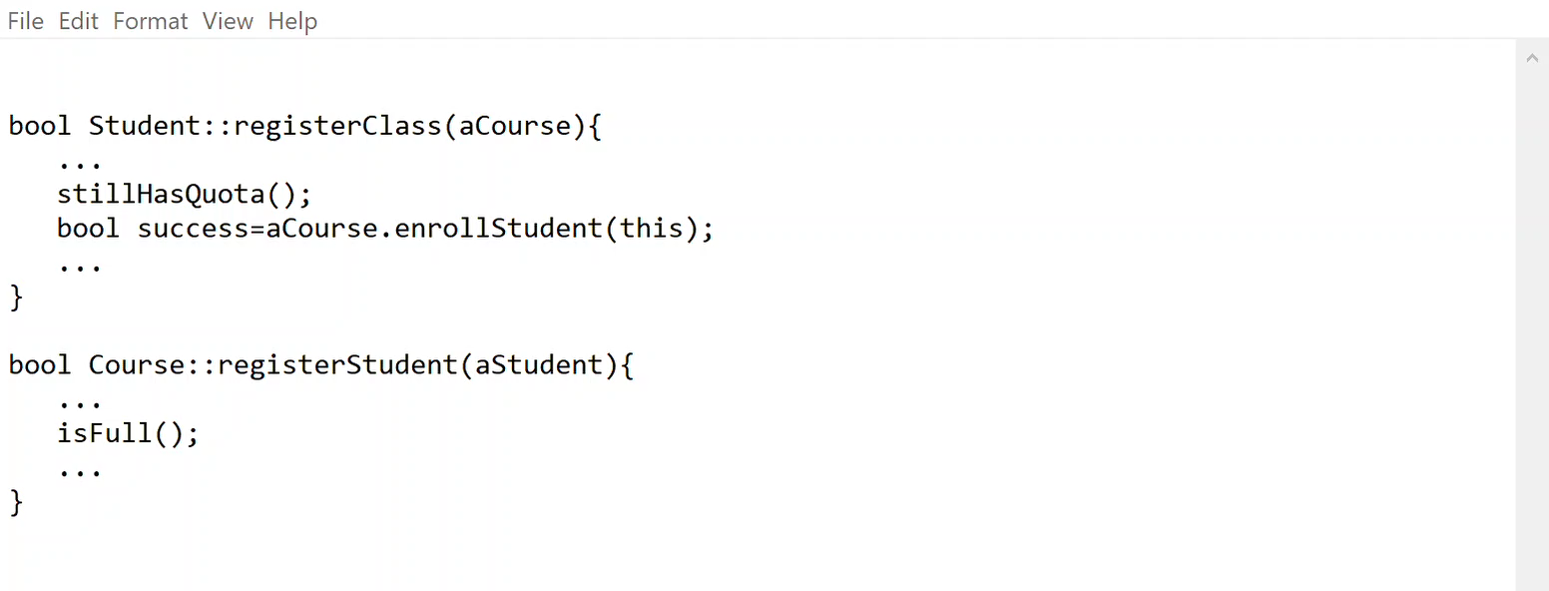
How to turn seq. diagram to code (2)
registerClasses(Course[] courses)
[for every course]
loop
alt
[full]
[else]
Hey, a video is embedded above with explanation.
Remember to click and watch!

Slide 12
How to turn seq. diagram to code (2)
bool Student::registerClasses(Course[] courses){
...
for(int i=0; i<courses.len; i++){
Course c=courses[i];
stillHasQuota();
bool success=c.enrollStudent(this);
...
}
}
bool Course::registerStudent(aStudent){
...
bool full=isFull();
if(full==TRUE)
addtoWaiting(aStudent);
else
addtoEnrolled(aStudent);
...
}
registerClasses(Course[] courses)
[for every course]
loop
alt
[full]
[else]

Slide 13
Summary
Class diagram
Sequence diagram

