Slide 1
Proxy Pattern presented by Ting Lu & Xinfu Lu

Slide 2
Part 1
Problem Context

Slide 3
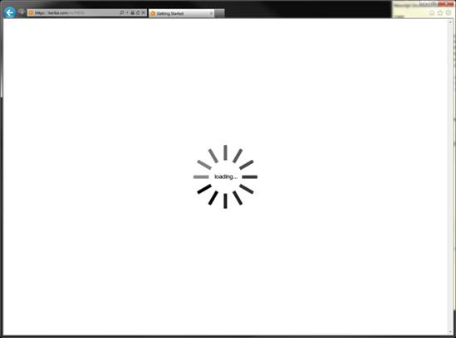
What’s the Design Problem?

Slide 4
What’s the Design Problem?
#1 Difficulties Opening Documents…
It takes forever to open a document with some graphical objects
(e.g. very large images)
But documents are supposed to open fast!
Example: Large images/tables/etc. inside a document
Solution: Virtual Proxy – use a placeholder class that only loads the info when the object is needed (info saved beforehand)

Slide 5
Benefit
Defer the full cost of its creation and initialization until we actually need to use it

Slide 6

Suppose we just got the 2018 Mclaren

Slide 7

Then the kid nextdoor
climbed onto the car…

Slide 8
What’s the Design Problem?
#2 Access Control
Make sure the right access is given to the right user
Example: Driver age check; Admin/User access check
Solution: Protection Proxy – use a surrogate class to check whether the caller has sufficient access permissions to perform a request.

Slide 9
What’s the Design Problem?

Slide 10
What’s the Design Problem?
#3 Object resides in a different address space
Need to interact with an object in a different address space
Example: ATM machines, need to retrieve data from bank database; Webpages, need computer network to retrieve data from remote server
Solution: Remote Proxy – Uses a local class for an object in a different address space

Slide 11
Recap
#1 Virtual Proxy
#2 Protection Proxy
#3 Remote Proxy
We’ll illustrate the first two here

Slide 12
Part 2
Description of Example

Slide 13
Definition & Intent
By providing a surrogate or placeholder class for the object
to have control access to the object

Slide 14
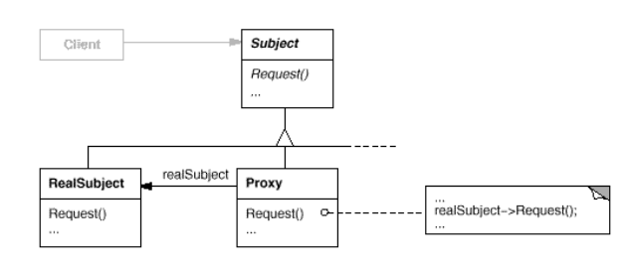
UML
Instead of load RealSubject, the Client will interact with Proxy, and request() is handled by Proxy.

Slide 15
Our example – REGIS System Application

Slide 16
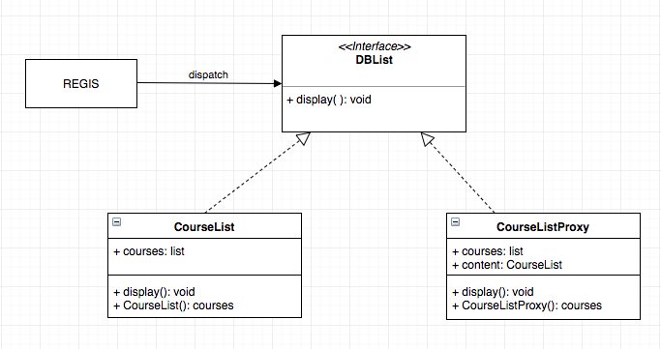
CourseList Loading - #1 Virtual Proxy
REGIS (Client) wants to show a list from database, CourseListProxy (Proxy) then display()

Slide 17
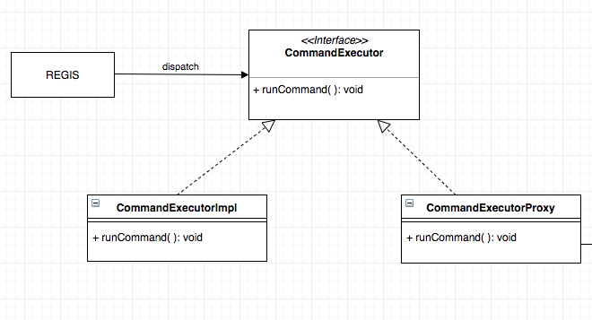
Admin Access Check - #2 Protection Proxy

Slide 18
Part 3
Implementation in Python

Slide 19
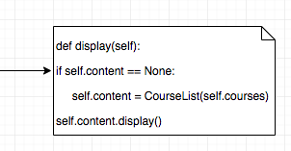
CourseList Loading - #1 Virtual Proxy
REGIS (Client) wants to show a list from database, CourseListProxy (Proxy) then display()

Slide 20
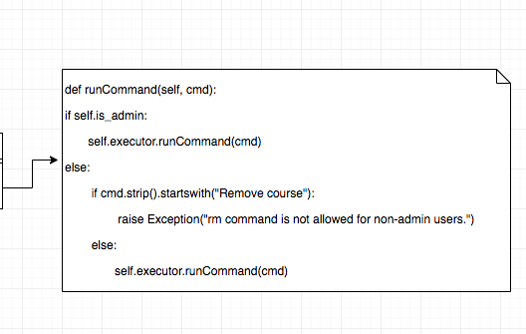
Admin Access Check - #2 Protection Proxy

Slide 21
Summary
#1 Virtual Proxy
#2 Protection Proxy
#3 Remote Proxy

Slide 22
Proxy is applicable whenever there is a need for a more versatile or sophisticated reference to an object than a simple pointer

Slide 23

THANKS!
Any questions?

