Slide 1
Builder Pattern
Yifan Shao
Notes:
lHello everyone, I’m Yifan Shao. Today i’m introducing Builder pattern.

Slide 2
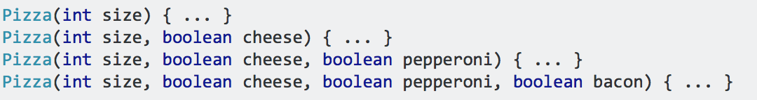
Problem
Builder pattern provides a solution to Telescoping Constructor Pattern.
What’s Telescoping Constructor Pattern?
For example, when creating a pizza object
Notes:
Builder pattern is designed to provide a solution to Telescoping constructor pattern,
And what is a telescoping constructor pattern?
We‘ve all at some point encountered a class with a list of constructors where each addition adds a new option parameter.
Let’s take making pizza as an example. In a pizza restaurant, we have to server different types of pizzas.
When we create a pizza object. There might be lots of arguments like size, cheese, topping, sauce and so on.
So sometimes we will have multiple constructors like the picture here, which is really confusing.
The problem with this pattern is that once constructors are 4 or 5 parameters long it becomes difficult to remember the required order of the parameters as well as what particular constructor you might want in a given situation.

Slide 3
Solution
Instead of using numerous constructors, the builder pattern uses another object, a builder, that receives each initialization parameter step by step and then returns the resulting constructed object at once.
Notes:
So we have builder pattern to solve this problem
Instead of …

Slide 4
Purpose of Builder Pattern
Separate the construction of a complex object from its representation so that the same construction process can create different representations.
Notes:
Now lets take a look at the purpose of this pattern. Some data structures are complicated to construct, due to their construction needing:
a large number of inputs
compound data (e.g. slices)
optional configuration data
choice between several flavors
which can easily lead to a large number of distinct constructors with many arguments each.

Slide 5
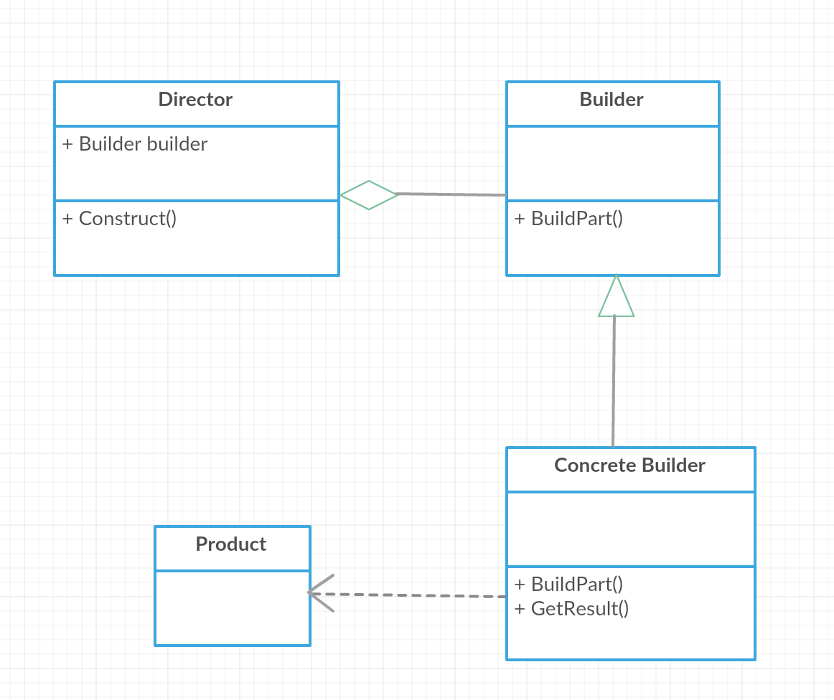
Structure
Notes:
In builder pattern, there is a abstract Builder class with interface BuildPart(). And there may be several concrete builder classes to implement the buildpart() method. And there is a Director class, it contains a Builder object and has a method to construct the products.
In our pizza example, a director may be a waiter, and builder can be a pizzabuilder, it has several subclasses, for example, hawaiianpizzabuilder or spicy pizzabuilder. Inside these subclasses, there will be methods to make a pizza.
Now let’s take a look at the implementation of this pizza example.

Slide 6
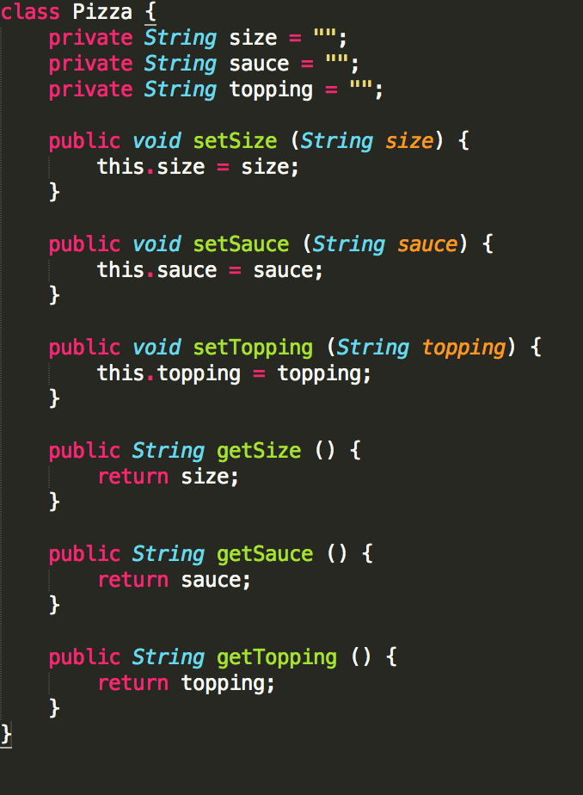
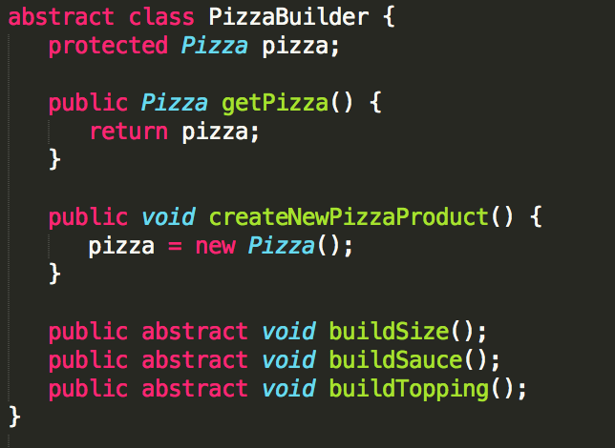
Code Implementation
Notes:
Here is the pizza class, to simplify, it has three members, size, sauce and topping. Also we have some get and set functions of these variables.
If we want to add some more members, we can simply add to this pizza class.
And on the right is PizzaBuilder class, it is an abstract class with three abstract methods buildSize, buildSauce and buildTopping. If we want to add a variable in the Pizza class, we have to add a function here.

Slide 7
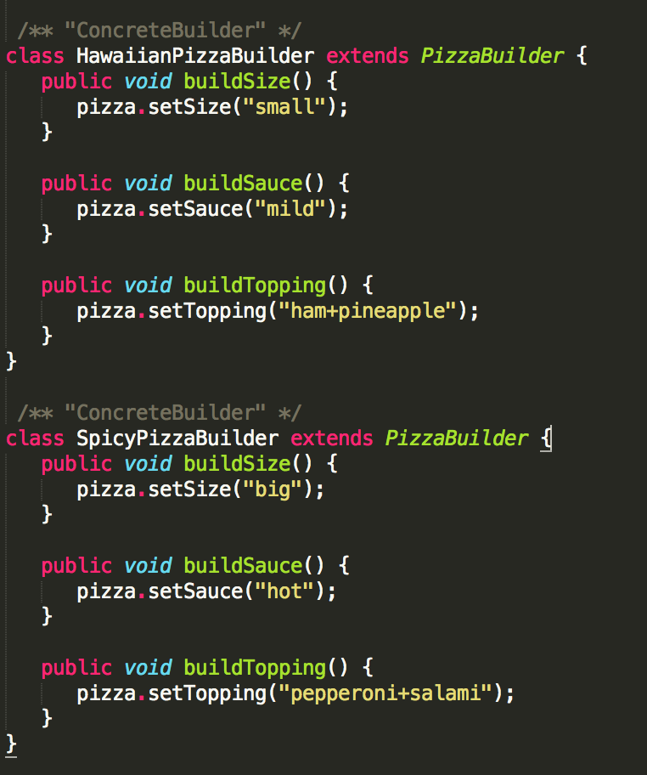
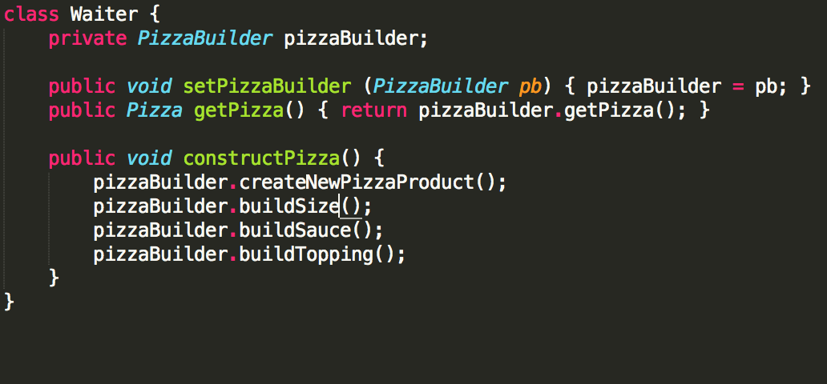
Code Implementation
Notes:
On the left is two subclasses of pizzabuilder, hawaiian pizza builder and spicy pizza builder. Inside these builders, we can see they implements builders of different parts of the pizza. If we want to add more types of pizza, we can create a new subclass and set the parameters of a pizza here.
On the right is Waiter class, it has a pizzabuolder object and has a method to construct pizza.

Slide 8
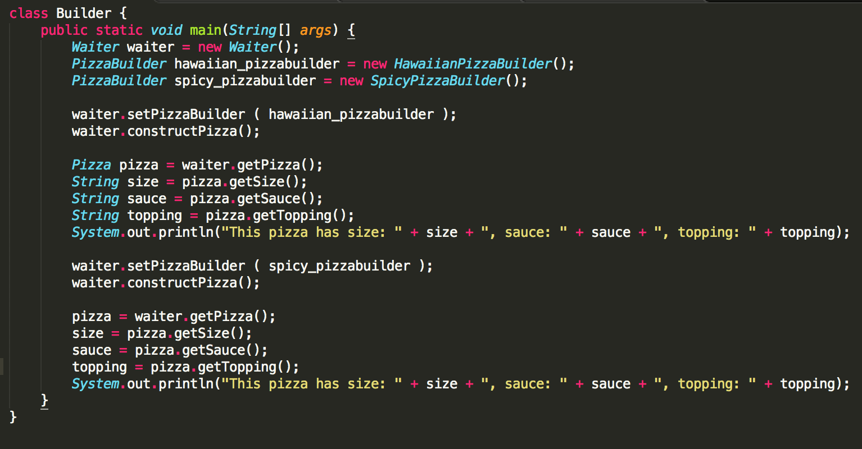
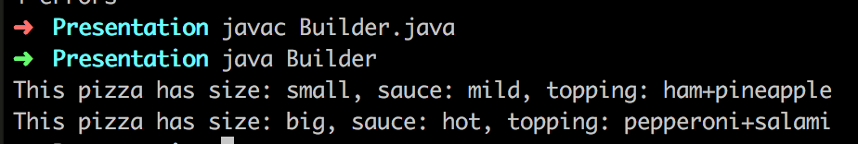
Code Implementation
Notes:
Now let’s test the builder. First we create a waiter object. If we want a hawaiian pizza, we can create a hawaiian pizza builder can set the builder of waiter to it. Then we can call the construct pizza function and get the result.
If we want a spicy pizza, it’s all the same.
On the right is the result of this program. We can see we constructed two different pizzas.

Slide 9
Conclusion
This pattern is flexible and it is easy to add more parameters to it in the future.
It is really only useful if you are going to have more than 4 or 5 parameters for a constructor.
That said, it might be worthwhile in the first place if you suspect you may be adding more parameters in the future.
Notes:
From the example we can see that we can make code easy to write and very easy to read and understand. In this example, the build method could be modified to check parameters and throw an IllegalStateException if an invalid parameter value has been supplied. When we want to add more parameters, it is really easy to do so.
So we can conclude that this pattern is flexible and
allows you to vary a product’s internal representation.
Encapsulates code for construction and representation.
Provides control over steps of construction process.
But it also has some disadvantages
Requires creating a separate ConcreteBuilder for each different type of Product.
Requires the builder classes to be mutable.

