Slide 1
Builder Design Pattern
Betty Chen

Slide 2
Builder belongs to Creational Pattern
Creational | Structural | Behavioral
Factory Method Abstract Factory Builder Prototype Singleton | Adapter Bridge Composite Decorator Flyweight Facade Proxy | Interpreter Template Method Chain of Responsibility Command Iterator Mediator Memento Observer State Strategy Visitor
Notes:
What’s the creational Pattern:
Answer:
These design patterns provide a way to create the objects while hiding the creation logic, rather than initiatiating the object directly using new operator.
This gives more flexibility in deciding which objects need to be created for an given use case.
2. What’s the difference between these creation patterns?
Builder pattern builds the final object step by step instead of implementing it with a single try.

Slide 3
Builder
Purpose:
Separate the construction of a complex object from its representation so that the same construction process can create different representation.
Advantages:
1. It lets you vary a product’s internal representation.
2. It isolates code for construction and representation
  3. It gives you finer control over the construction process.
What makes the difference among these creational patterns:
Build the final project step by step
Builder is independent of other objects in the pattern

Slide 4
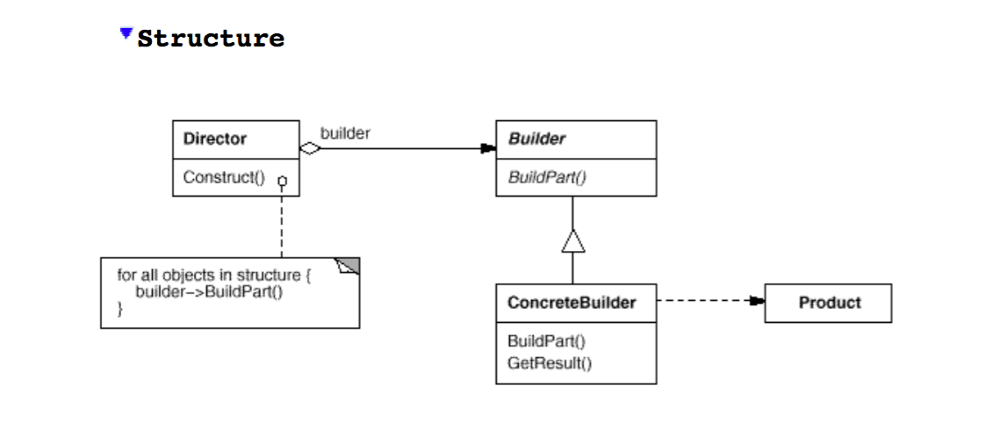
Builder- UML Diagram
Interface
Builder
Specifies an abstract interface for cheating parts of a product object
Concrete Builder
Constructs and assemble parts of the product by implementing the builder interface
Define and keeps track of the representation it creates
Provides an interface for retrieving the product
Director
Constructs an object using the builder interface
Product
Represent the complex object under construction.

Slide 5
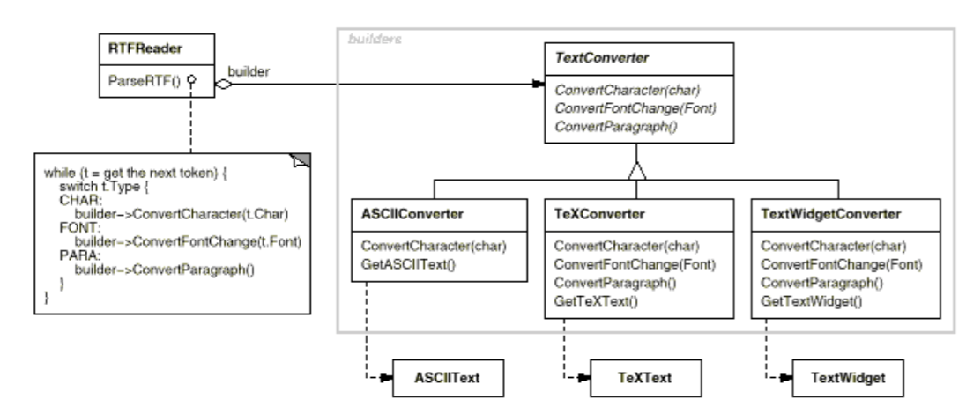
Builder- Example
Interface

Slide 6
Builder
Advantages:
1. It lets you vary a product’s internal representation
-hide the representation and internal structure of the product
-hides how the product gets assembles
2. It isolates code for construction and representation
-improves modularity by encapsulating the way a complex object is
constructed and represented
-The concrete Builder contains all the code to create and assemble a
particular kind of product
  3. It gives you finer control over the construction process
What makes the difference among these creational patterns:
Build the final project step by step
Builder is independent of other objects in the pattern

Slide 7
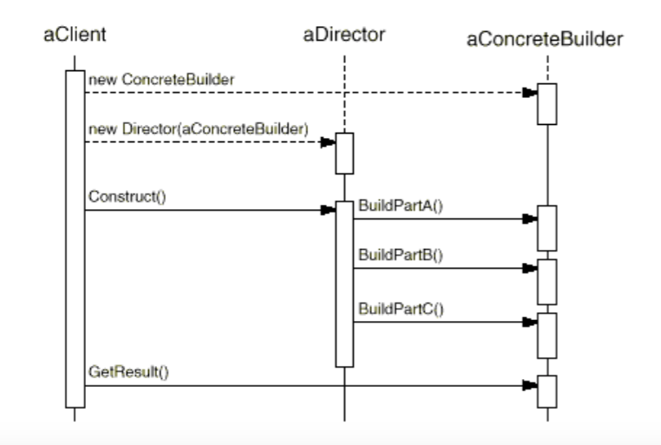
Builder- Collaborations
The client creates the Director object and configures it with the desired Builder object.
Director notifies the builder whenever a part of the product should be built.
Builder handles requests from the director and adds parts to the product.
The client retrieves the product from the builder.

Slide 8
RTFReader
ASCIIText
RTF file
Parser
Converter
TexText
TextWidget

